Slide 1

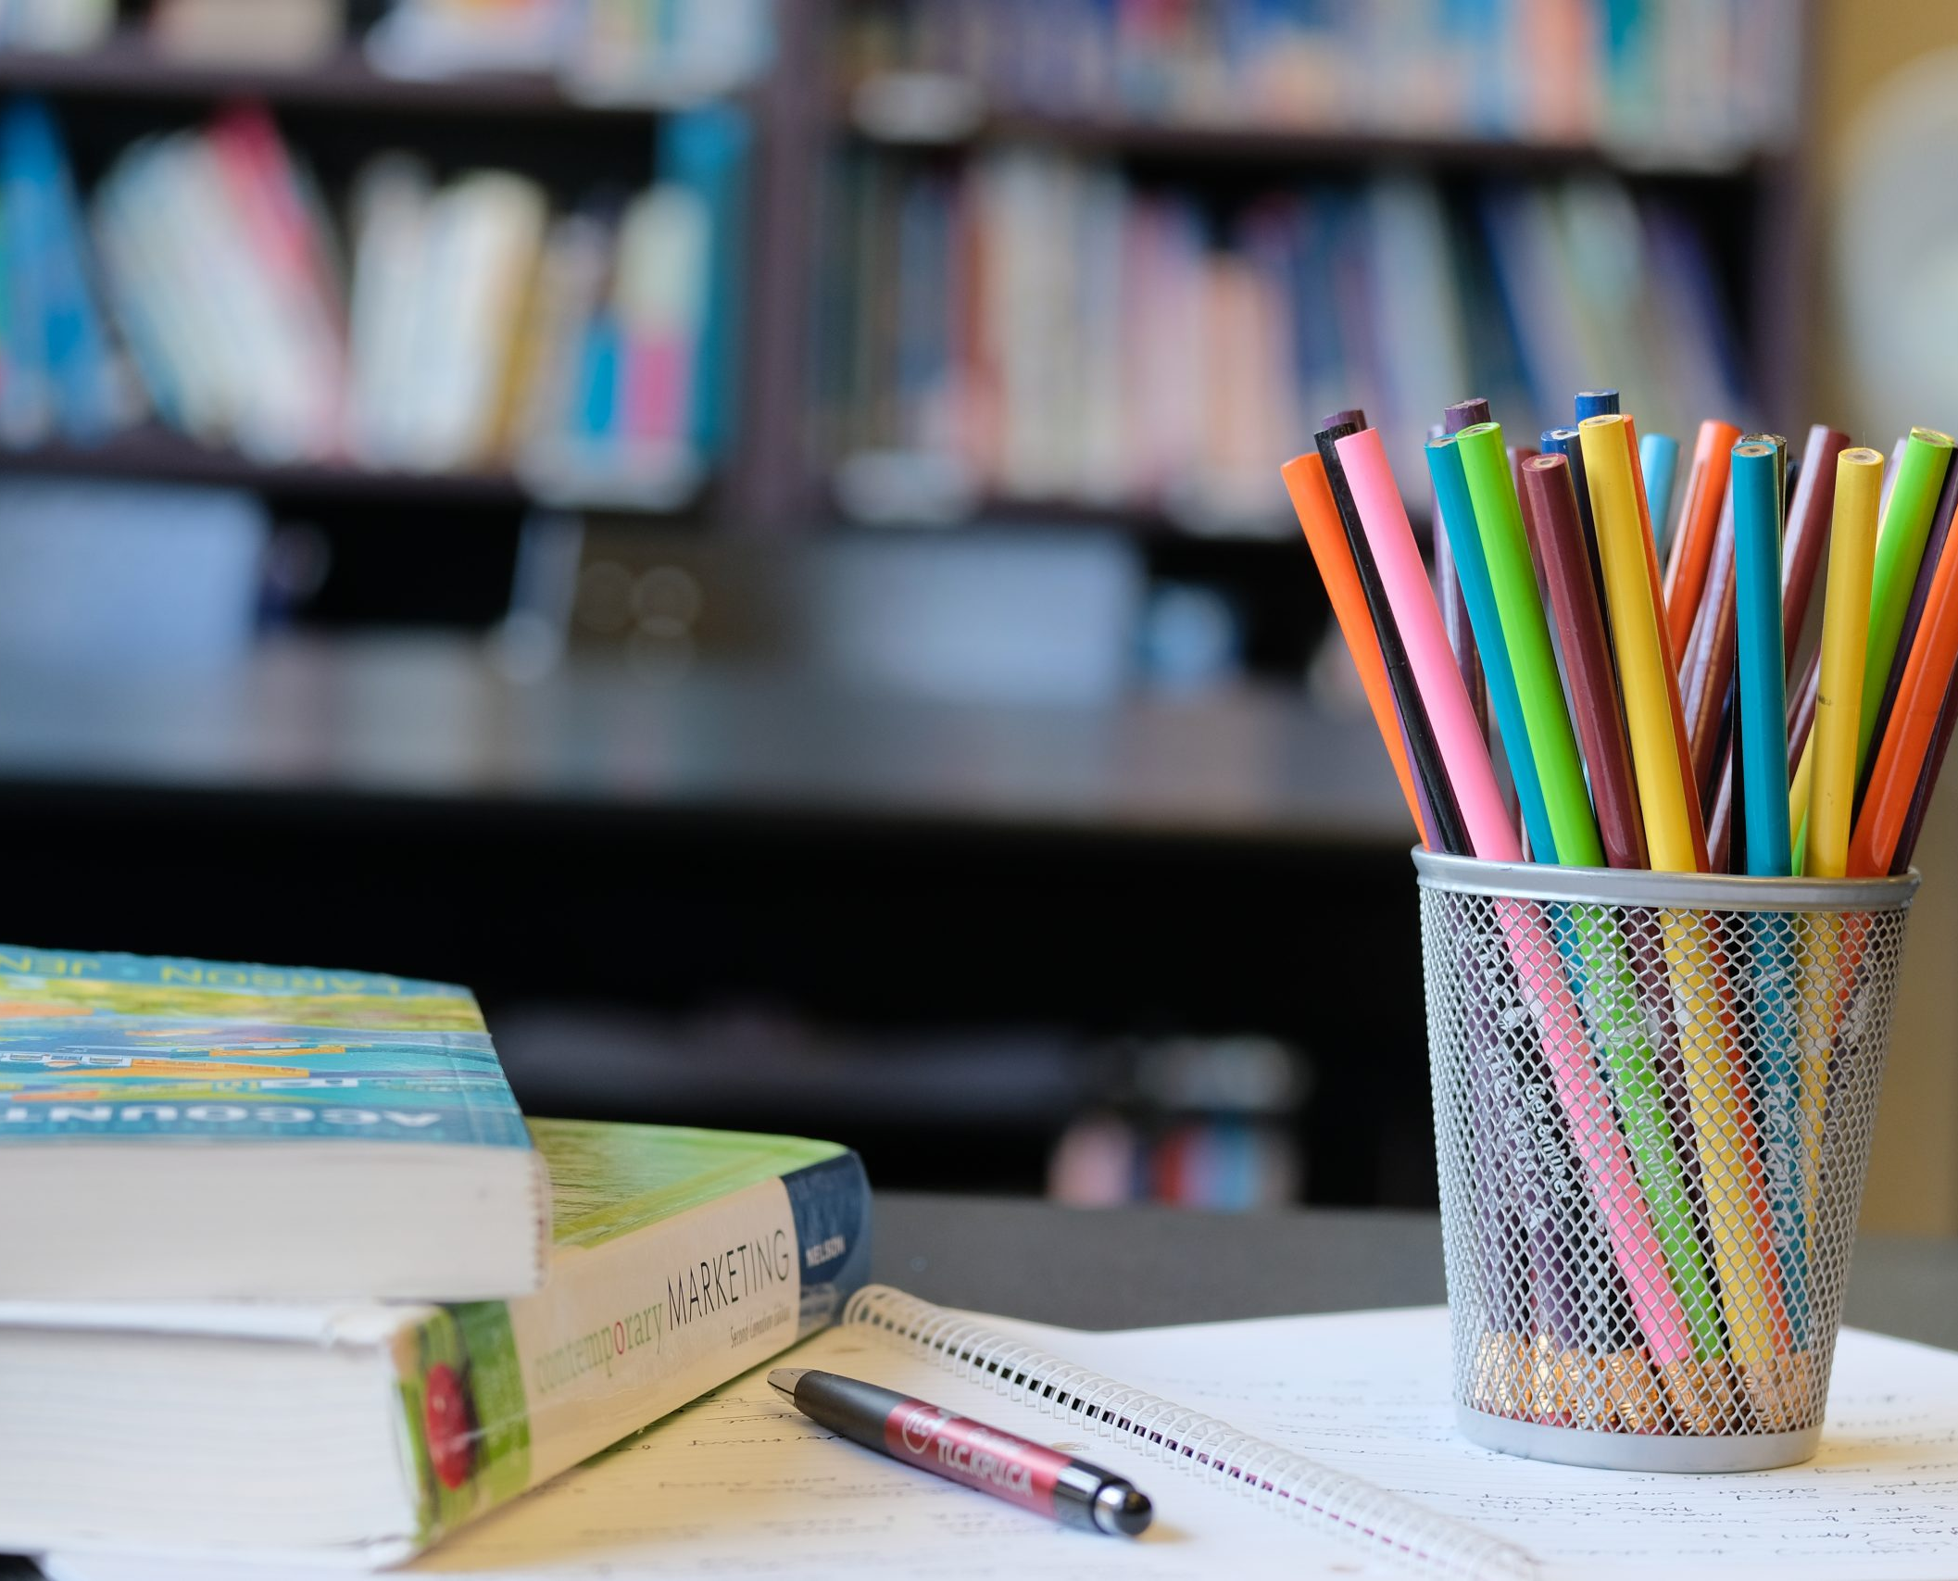
Welcome TO QUANTITATIVE APTITUDE & REASONING DIVISION
university
QUANT &
REASONING

Slide 2
SIMPLE EQUATIONS & AGES

Slide 3
SIMPLE EQUATIONS
Expression : An Algebraic Structure which involves Variables and constants, apply the arithmetic operation is called Expression.
Equation : Expression = 0 is called Equation or Equating any two expressions is called Equation.
Simple Equation : An equation involving the variables the maximum of order is 1 then it is called Simple Equation.

Slide 4
SIMPLE EQUATIONS
1. An amount of Rs. 5,600 is divided among A, B and C. The sum of the shares of ‘B’ and ‘C’ is equal to thrice the share of “A” and the sum of the shares of “A” and “C” is equal to Nine – Fifth of the share of B. What is the share of ‘C’ ?
a.. Rs. 1,400 b. Rs. 2,400 c. Rs. 2,200 d. Rs. 2,000

Slide 5
SIMPLE EQUATIONS
2. A and B have some marbles with them. A says to B, “if you give one marble to me, we will have equal number of marbles”. B Says to A “if you give me one marble, I will have twice the number of marbles you have”. How many marbles do A and B have respectively?
a. 4,6 b. 5,7 c. 6, 4 d. 7,5

Slide 6
SIMPLE EQUATIONS
3. In two hours A can walk two kilometers less than what B can walk in three hours. In one-hour, A walk one kilometer more than B. How many kilometers can A walk in Five hours ?
a. 25 b. 16 c. 20 d. 12

Slide 7
SIMPLE EQUATIONS
4. A two-digit number “ T ” is added to the number formed by reversing its digits. The sum obtained is 99. The tens digit of T was twice its units digit. Find the tens digit?
4 b. 6 c. 8 d. 2

Slide 8
SIMPLE EQUATIONS
5. On the first day man earns Rs.20 and spends Rs.15 on the next day. He again earns Rs.20 on the third day and spends Rs.15 on the fourth day. If he continuous to save like this, how soon will he have Rs. 60 in hand?
a. On 17th day b. On 27th day c. On 30th day d. On 40th day

Slide 9
SIMPLE EQUATIONS
6. Number of digits used numbering the pages in a book having 366 pages is:
a.732 b.990 c.1098 d.1305

Slide 10
SIMPLE EQUATIONS
7. A boy was asked to multiply a number by 25. He instead multiplied the number by 52 and got the answer 324 plus the correct answer. Multiplied the number is :
a.12 b.15 c.25 d.32

Slide 11
SIMPLE EQUATIONS
8. A boy read 3/8th of a book on one day and 4/5th of the remainder on another day. If there were 30 pages unread, How many pages did the book contain?
a.240 b.300 c.600 d.250

Slide 12
SIMPLE EQUATIONS
9. Rakesh wanted to buy a book costing Rs. 270 he had notes of Rs. 10, Rs. 20 and Rs. 100 only. In how many ways can he pays for the book such that he uses at least one note of each denomination ?
a.9 b. 10 c. 11 d. 12

Slide 13
SIMPLE EQUATIONS
10. A father has Six children he distributes some toffees among them equally. Each of them eats 4 toffees. The total number of toffees remaining with them was thrice the number of toffees each of them initially had. Find the initial number of toffees with the father?
a. 48 b. 42 c. 36 d. 54

Slide 14
SIMPLE EQUATIONS
11. In a groups of cows and ducks, the number of legs are 48 more than twice the number of heads. What is the number of cows in the group?
a.6 b.8 c.10 d.24

Slide 15
SIMPLE EQUATIONS
12. The total expenses of a hostel consist of two parts. One part is fixed and the other part varies directly with the number of occupants. When it had 180 occupants, its total expense was Rs. 1,92,000. When it had 240 occupants, its total expense was Rs. 2,16,000. Find its total expense when it had 270 occupants? (in Rs.)
a. 2,28,000 b. 2,36,000 c. 2,32,000 d. 2,24,000

Slide 16
SIMPLE EQUATIONS
13. A test consists of 50m questions. Each correct answer fetches 1 mark. For each wrong answer ½ mark is deducted. A candidate who wrote this test attempted all the questions. He scored 41 marks. Find the number of questions how correctly answered?
a. 46 b. 42 c. 48 d. 44

Slide 17
SIMPLE EQUATIONS
14. The cost of 10 kg of apples is equal to the cost of 24 kg of rice. The cost of 6 kg of flour equals the cost of 2 kg of rice. The cost of each kg of flour is Rs.20.50. Find the total cost of 4 kg of apples, 3 kg of rice and 5 kg of flour?
a. Rs.849.40 b. Rs.877.40 c. Rs.901.60 d. Rs.815.20

Slide 18
SIMPLE EQUATIONS
15. In a regular week, there are 5 working days and working hours are 8 for each day. A man gets Rs.2.40 per hour for regular work and Rs.3.20 per hours for overtime. If he earns Rs.432 in 4 weeks, then how many hours does he work for?
a.160 b.175 c.180 d.195

Slide 19
SIMPLE EQUATIONS
16. Twenty years from now, Sreedhar will be Six times as old as he was twenty years ago. What is the present age of Sreedhar ?
a. 20 years b. 24 years c. 28 years d. 32 years

Slide 20
SIMPLE EQUATIONS
17. The age of a father is Six times the age of his Son Twenty years from now, father’s age will be twice as old as son’s age. What is the father’s present age ? (in years)
a.25 years b. 40 years c. 30 years d. 20 years

Slide 21
SIMPLE EQUATIONS
18. Mrudhula gave birth to twins when she was twenty years old. After X years, the sum of the ages of Mrudhula and her twin children is 50 years.What is the value of X ?
a. 5 b. 10 c. 15 d.20

Slide 22
SIMPLE EQUATIONS
19. Five years ago, a father was thrice as old as his son fifteen years hence he will be twice as old as his son. Find the present age of his son (in years)
a. 20 b. 15 c. 30 d. 25

Slide 23
SIMPLE EQUATIONS
20. Alok’s age is twice that of his son. His wife is 30 years older that his son. When his son was born he was 35 years old. Find his wife’s present age (in years)?
a. 55 b. 65 c. 70 d. 60

Slide 24
SIMPLE EQUATIONS
1.c | 2.b | 3.a | 4.b | 5.a | 6.b | 7.a | 8.a | 9.c | 10.a
11.d | 12.a | 13.d | 14.b | 15.b | 16.c | 17.c | 18.b | 19.b | 20.b

Slide 25

This Photo by Unknown Author is licensed under CC BY-SA

